Slide 1
Chapter 3
Customizing your environment

Slide 2
CONTENT
01
03
The .bash_profile, .bash_logout, and .bashrc Files
Options
02
04
Aliases
Shell variables

Slide 3
CONTENT
05
Customization and sub processes
06
Customization hints

Slide 4
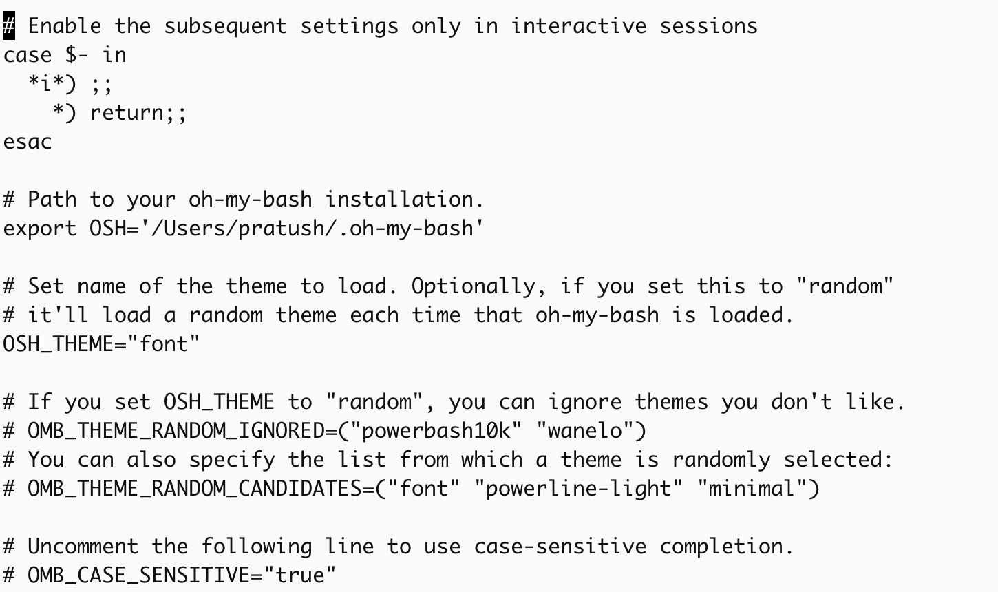
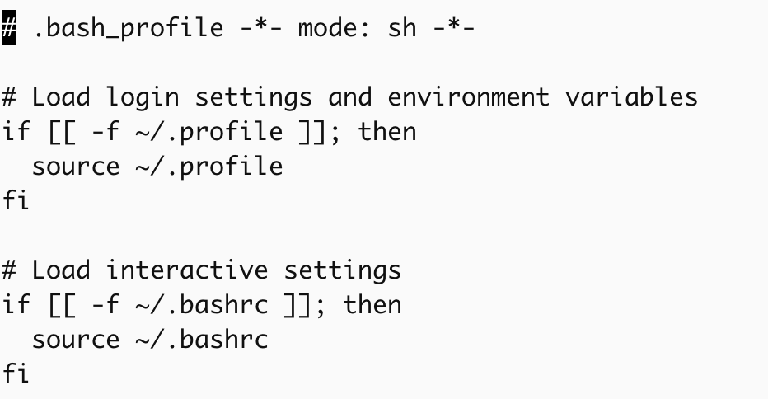
The .bash_profile, .bash_logout, and .bashrc Files
.bash_profile,is read and the commands in it is executed by bash every time you login to the system.
your .bash_profile won’t take effect until the file is re-read by logging out and then logging in again. Alternatively you can use the source command i.e. source .bash_profile
If .bash_profile doesn’t exist in your home directory, then bash will look for .bash_login. If that doesn’t exist it will look for.profile.
.bash_profile is read and executed only by the login shell. If you start up a new shell (asubshell) by typing bash on the command line ,it will attempt to read commands from the file .bashrc. The file .bash_logoutis read and executed every time a login shell exits.

Slide 5
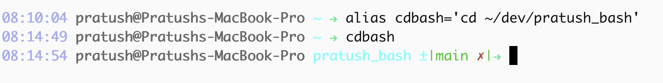
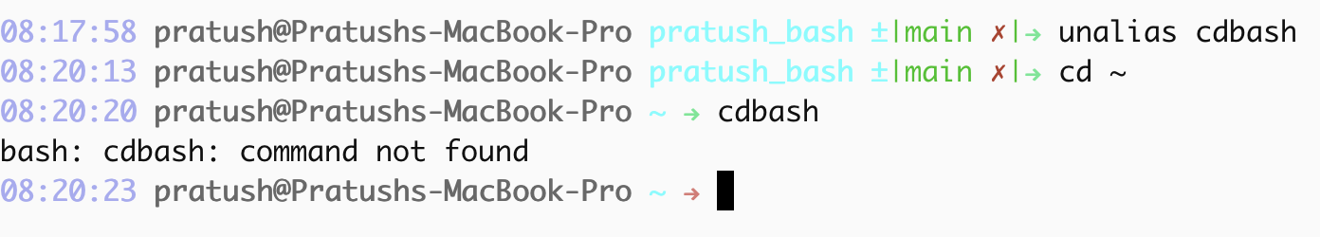
Aliases
Aliases can be defined on the commandline, in your .bash_profile, or in your .bashrc, using this form:
alias name=command
alias cdvoy='cd sipp/demo/animation/voyager' (the single quotes around the full cd command; these are necessary if the string being aliased consists of more than one word.)
The command unalias name removes any alias definition for its argument.

Slide 6
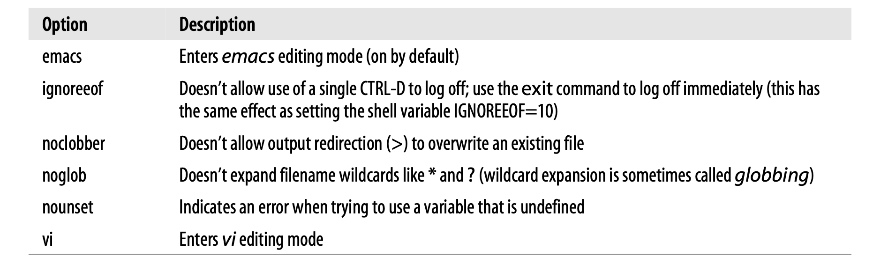
Options
Options let you change the shell’s behaviour. A shell option is a setting that is either “on” or “off.”
set-o optionname and set +o optionname.You can change more than one option with the one set command by preceding each optionname with a -o or +o. The use of plus (+) and minus (-) signs is counterintuitive: the- turns the named option on, while the + turns it off.

Slide 7
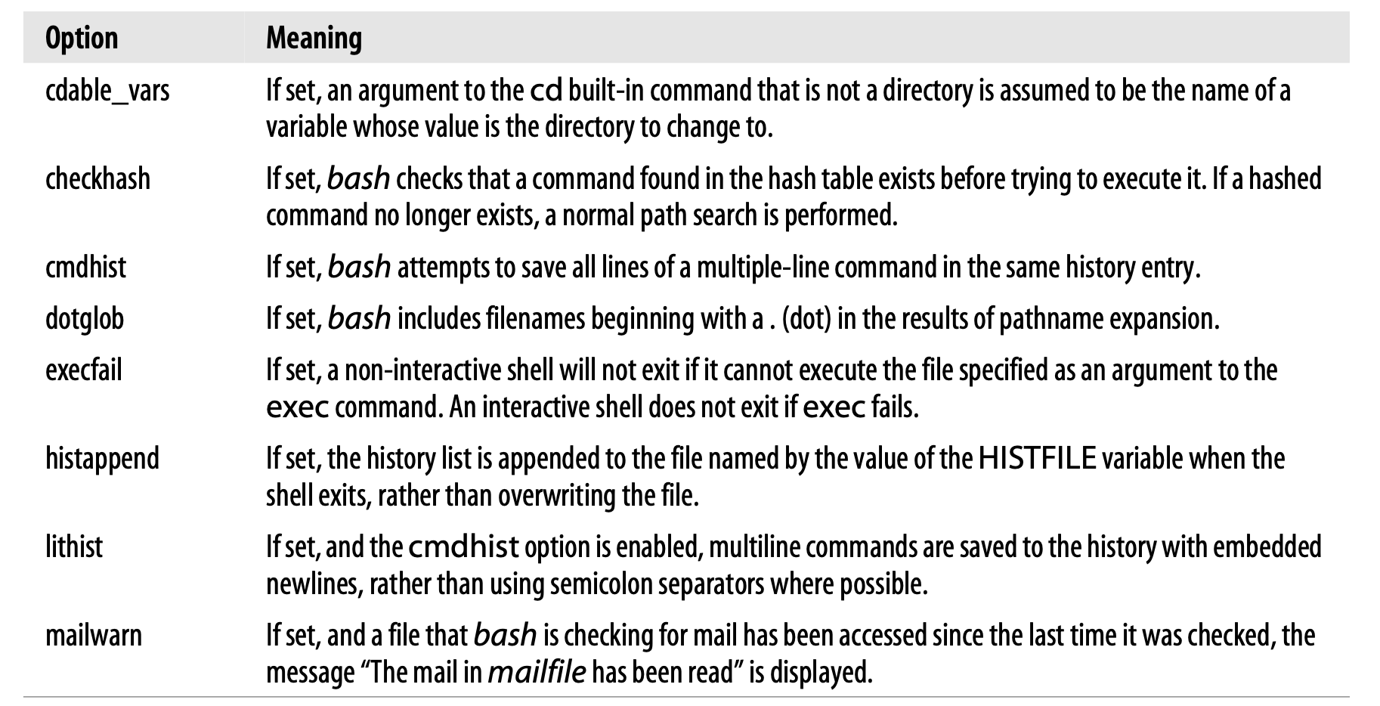
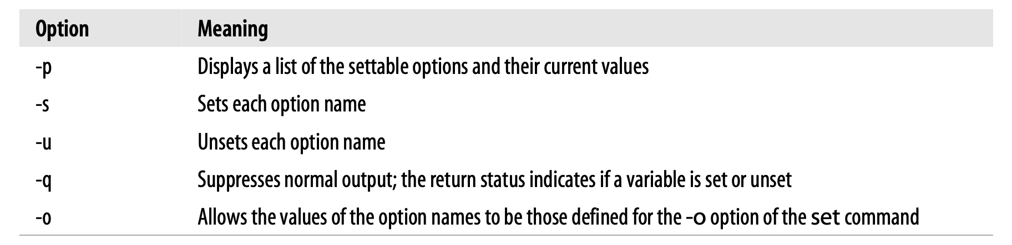
Options
bash 2.0 introduced a new built-in for configuring shell behaviour, shopt. This built-in is meant as a replacement for option configuration originally done through environment variables and the set command.
The shopt-o functionality is a duplication of parts of the set command and is provided for completeness on the part of shopt, while retaining backward compatibility by its continued inclusion in set.
When the -p option is used, shopt displays a list of the settable options and the values that they currently have. If -s or -u is also given, the list is confined to only those options that are set or unset, respectively.

Slide 8
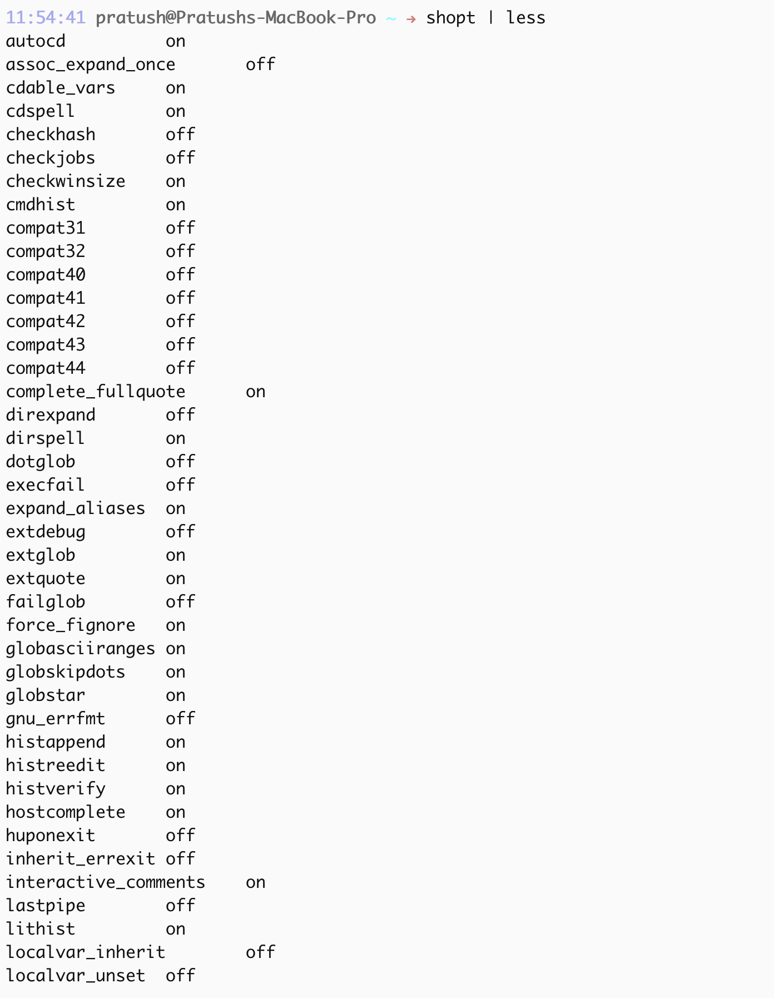
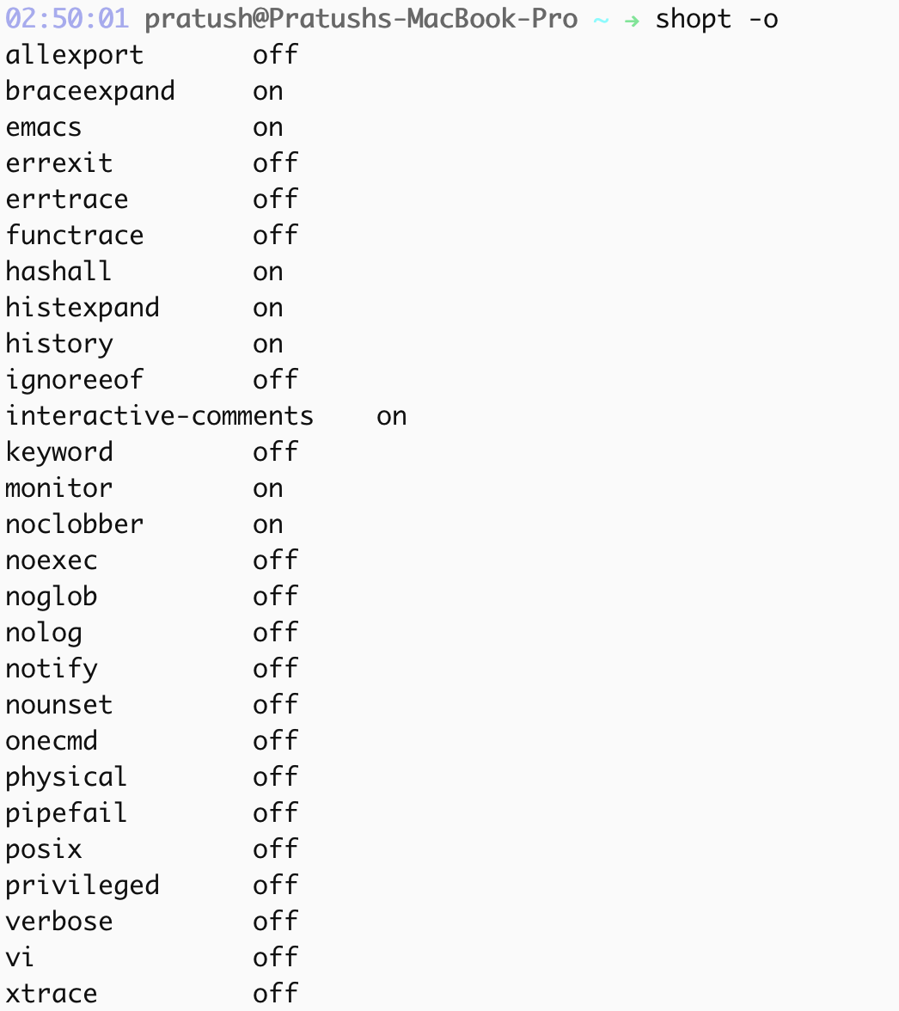
Options

Slide 9
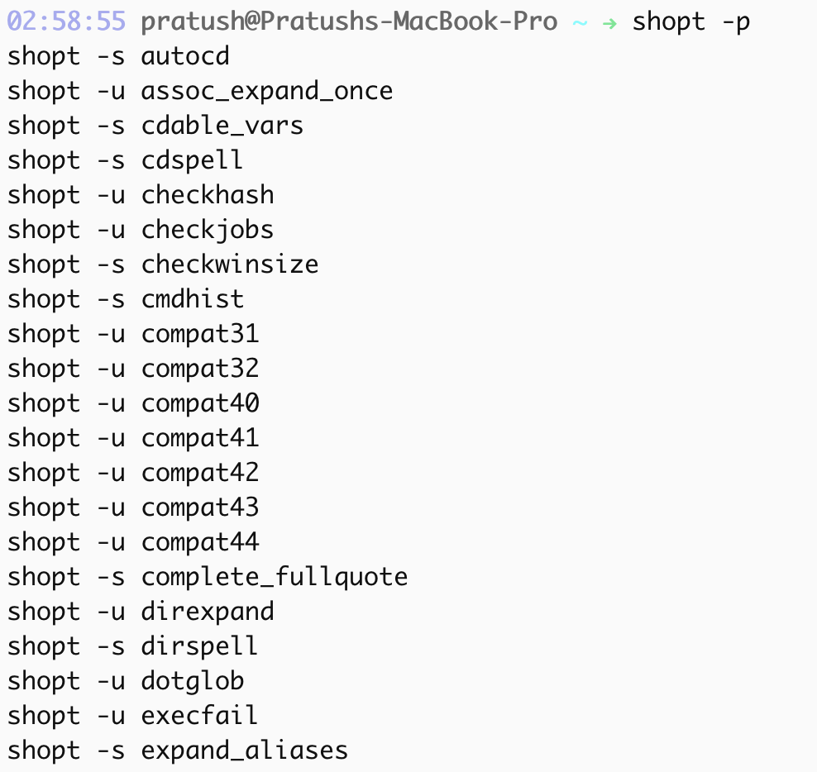
Options

Slide 10
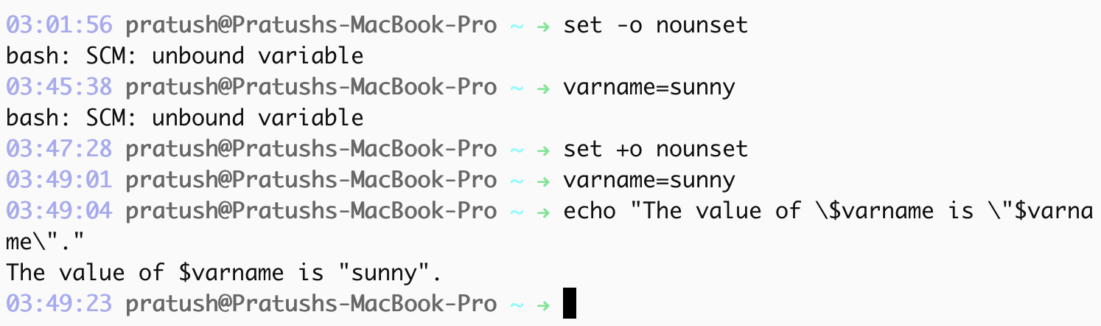
Shell variables
A shell variable, like an alias is a name that has a value associated with it.
varname=value
To use the value of a variable in a command, precede its name by a dollar sign ($).
You can delete a variable with the command unset varname.
But if you use the set option nounset, which causes the shell to indicate an error when it encounters an undefined variable.
The dollar sign survives the double quotes and for it to be taken literally it must be backslash escaped instead.

Slide 11
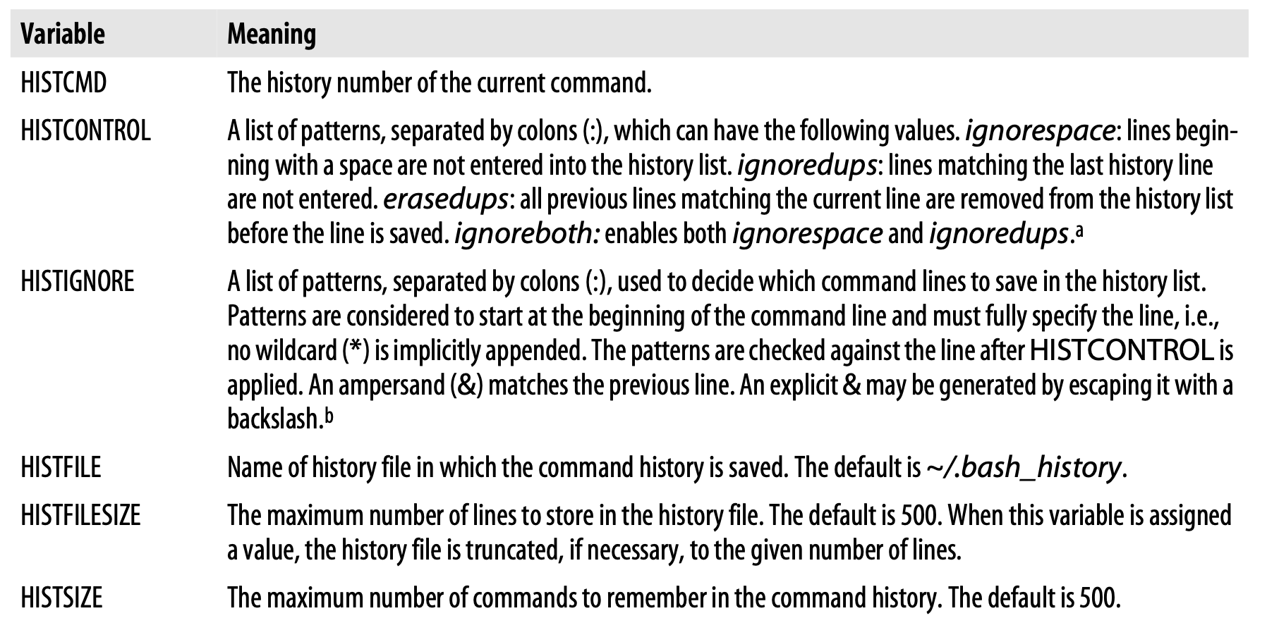
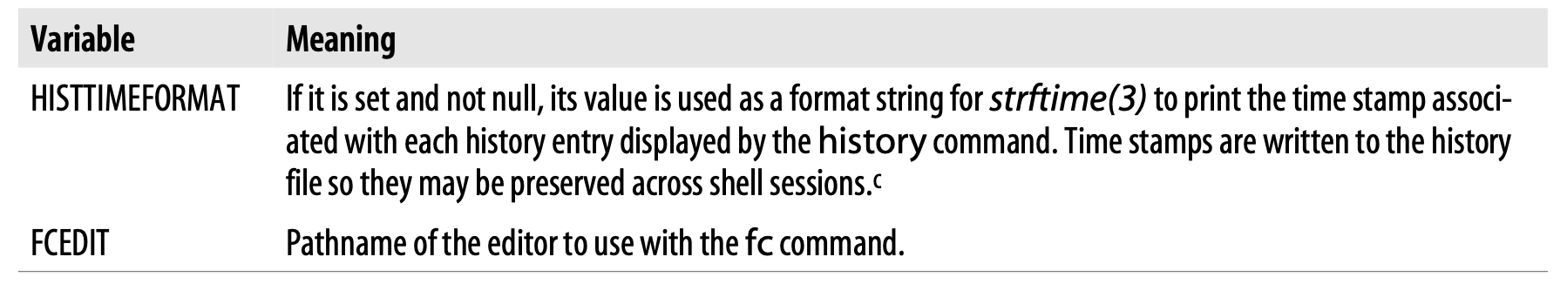
Shell variables
Without the double quotes, the shell splits the string into words after substituting the variable’s value, as it normally does when it processes command lines.
The double quotes circumvent this part of the process (by making the shell think that the whole quoted string is a single word).

Slide 12
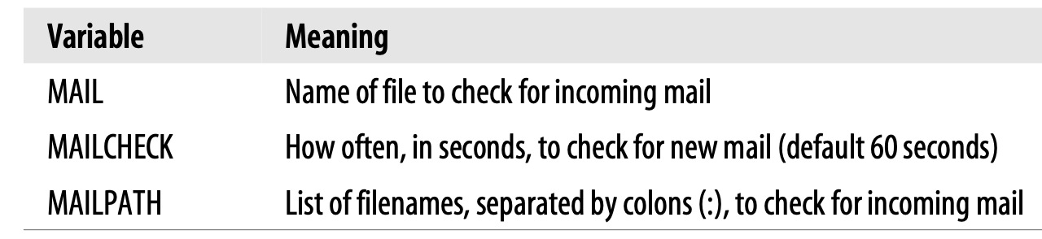
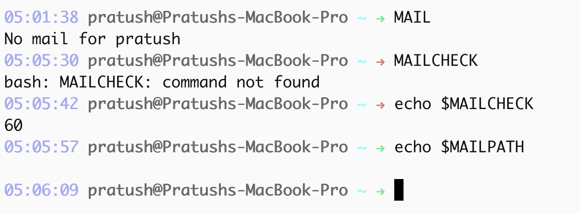
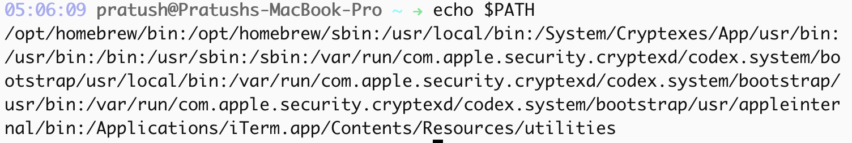
Shell variables
Mail variables
The shell can’t actually check for incoming mail, but it can look at your mailfile periodically and determine whether the file has been modified since the last check.
Prompting variables
bash uses four prompt strings. They are stored in the variables PS1,PS2, PS3,andPS4. The first of these is called the primary prompt string; it is your usual shell prompt, and its default value is “\s-\v\$ ”.
\u tells bash to insert the name of the current user into the prompt string.

Slide 13
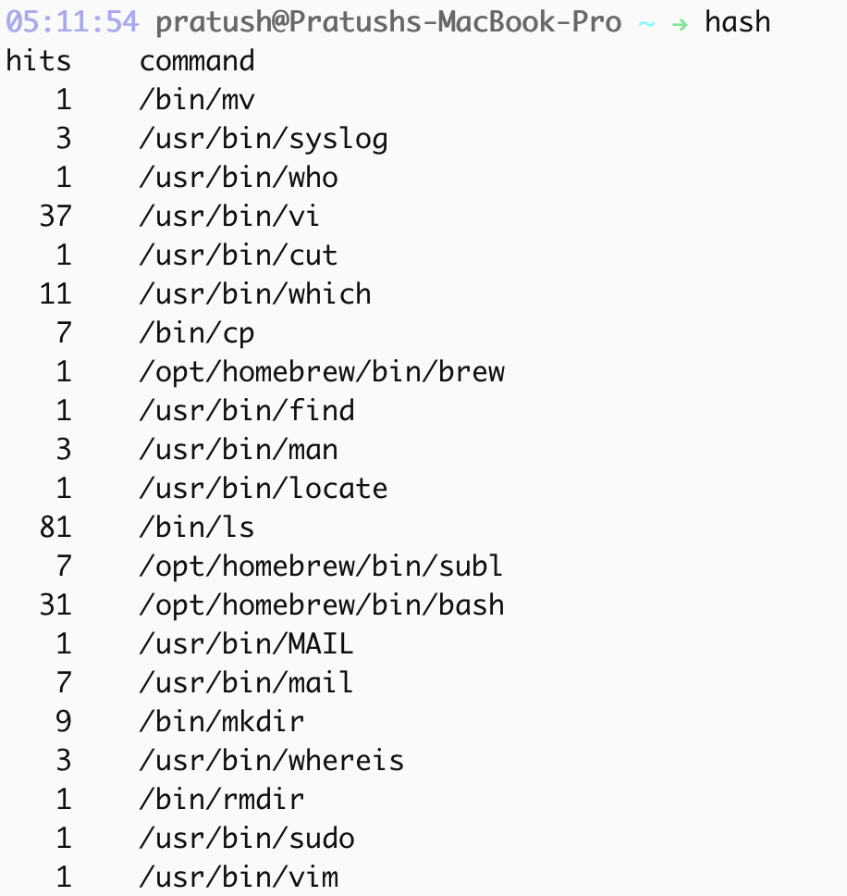
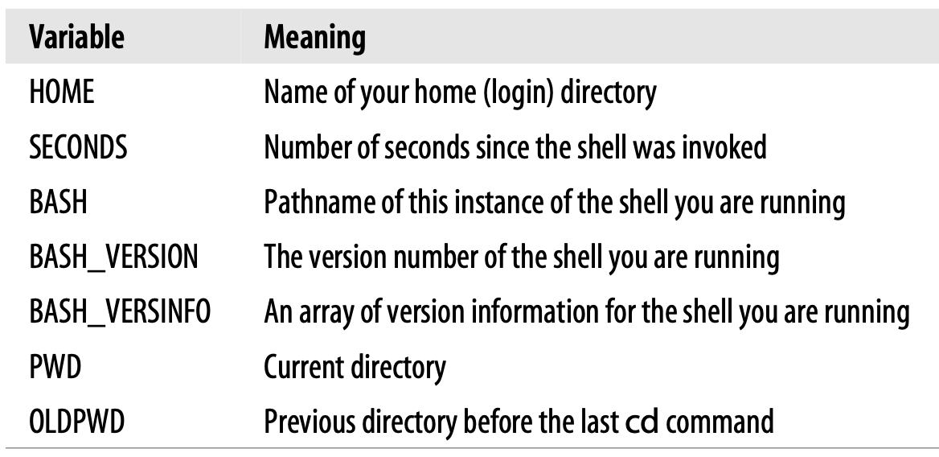
Shell variables
To speed things up, bash uses what is known as a hash table.
bash first checks the hash table to see if the command is listed. If it is, it uses the path given in the table and executes the command; otherwise, it just has to go and look for the command in the search path.
CDPATH is a variable whose value, like that of PATH, is a list of directories separated by colons. Its purpose is to augment the functionality of the cd built-in command.
if you type cddoc, then the shell will look in the current directory for a (sub)directory called doc. Assuming that it doesn’t find one, it looks in the directory ~/sipp/demo/animation/voyager.

Slide 14
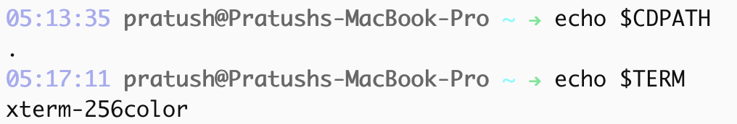
Customization and sub processes
Whenever you enter a command, you are telling the shell to run that command in a subprocess; furthermore, some complex programs may start their own subprocesses.
Environment Variables:
HOME, MAIL, PATH, and PWD
Text editors like vi and emacs need to know what kind of terminal you are using; the environment variable TERM is their way of determining this.
export varnames
Remember to have the line source .bashrc at the end of your .bash_profile so that the definitions become available to the login shell.

Slide 15
Customization hints
The best strategy is to test something out by typing it into the shell during your login session; then if you decide you want to make it a permanent part of your environment, add it to your.bash_profile.
Make sure that you use a double right-caret (>>). A single one will overwrite the file rather than appending to it.
Use echo 'PS1="\u \!—> " ' >> ~/.bash_profile, to customize your Bash prompt.

Slide 16
THANK YOU

